Slide 1
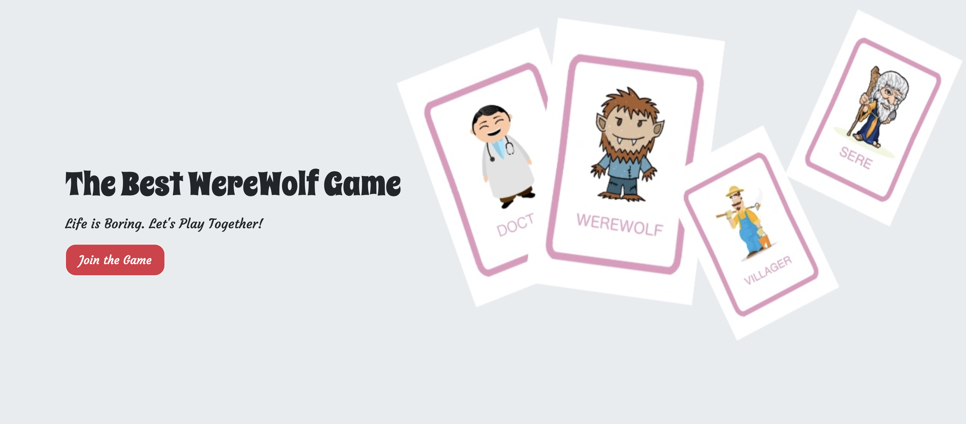
Second Sprint Presentation
Team 21
Ying Fang (yingfang)
Yaxuan Zhang (yaxuanz)

Slide 2
Backgrounds
Werewolf is a popular multiplayer board game
Tough for the game lovers to gather enough players in real
Intend to provide them with an ideal platform to play online with other people anywhere anytime

Slide 3
Goals for Sprint 1
Scrum tool: “Monday”
First sprint backlog: https://team21-bunch.monday.com/boards/503036907
Complete features with high priorities → medium and low priorities if time permits.

Slide 4
What we have completed
Began with building data model in Django
Focused on implementing each functionality as well as the user interface
Overall list of what we have completed so far: https://team21-bunch.monday.com/boards/506311110

Slide 5
Progress & Problems
Complex data model
Multi-players game: difficult to debug

Slide 6
Goals for Sprint 2
Second sprint backlog: https://team21-bunch.monday.com/boards/506406299
Critical features: game, profile
Other potential features: animations, background music, chat board with voice, profile charactor design and dress up

Slide 7
Thanks for listening!
Team 21
Yaxuan Zhang (yaxuanz)
Ying Fang (yingfang)

